Slide 1
Graduation
VS.
Commencement
What You Need To Know!

Slide 2
GRADUATION
What is it and how do you get there?

Slide 3

Graduation is Exciting!
But, be aware of important information!
Be sure you are checking your student email regularly!
Take special note of emails received from the KSC Graduation Office and Commencement
Follow the Facebook page for your graduation year!
If you have a question – ask! Don’t assume.

Slide 4

Graduation – The Basics
Graduation does not happen when you walk across the stage.
Graduation is a process that happens behinds the scenes.
    A final audit is completed to verify completion of all requirements
    Your graduation is processed in our system
    Diplomas are ordered and mailed
Completed by the Associate Registrar/graduation auditor.
Emails and Facebook posts are made to help provide information and where things are in the process. Be sure to read everything and save for future reference!

Slide 5


Graduation Vs. commencement
GRADUATION
COMMENCEMENT
Occurs three times a year
  May
  August
  December
Final audits are completed to verify requirements have been met.
Graduated students receive a letter and an unofficial transcript in the mail.
A celebration for students projected to successfully complete all their graduation requirements in that particular year.
Eligibility requirements must be met in order to attend.
Diplomas are not given at Commencement – they are all mailed.

Slide 6
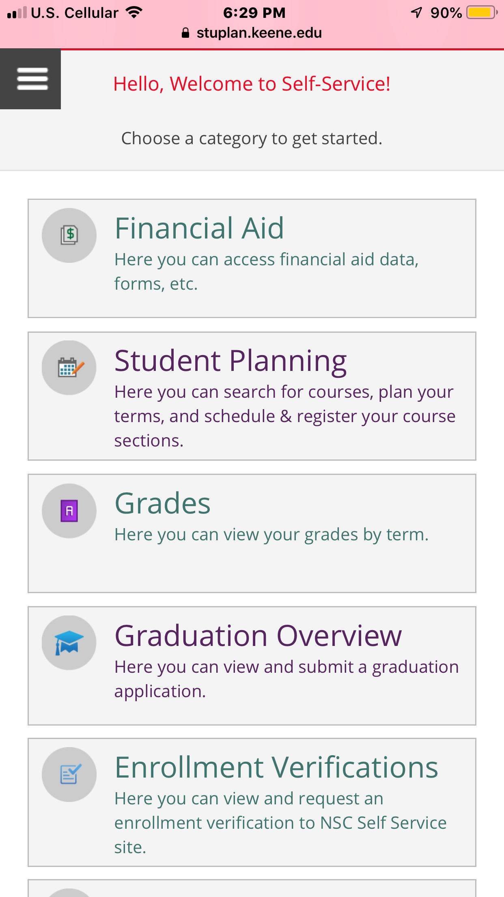

Applying to graduate
MAY
1st
WHEN?
Deadline to apply is May 1st of the calendar year before you plan to graduate.
      Ex. If you plan to graduate in 2022 (May, Summer, or Fall) you will apply to graduate by May 1st, 2021.
WHY?
We don’t know when you plan to graduate unless you tell us!
    You won’t get an audit
    You won’t be on the list of students to graduate
    It could impact Commencement eligibility
HOW?
Self Service – Graduation Overview

Slide 7
Guidelines For applying to graduate
Apply to graduate for the semester in which you will finish your degree requirements – not the semester you want to walk!
  Example: If you are planning to complete requirements in Fall 2022, but want to walk in May 2022, you will apply for Fall 2022.
Be sure that you are declared correctly PRIOR to applying to graduate.
Submit course substitutions before you apply to graduate when possible.
If you are completing a dual degree, you will need to apply to graduate for both degrees.

Slide 8
Declaration of Major
VERIFYING AND CHANGING DECLARATIONS
Verify how you are declared in self-service
  View ‘Progress Tab’
  Upper left hand corner under ‘At a Glance’
If this is incorrect, you will need to complete a Declaration of Major form
  Online forms located here: https://www.keene.edu/office/registrar/forms/
  Two options:
  ‘Declaration of Major Form’ – Used anytime you need an advisor’s signature
  .‘Declaration form for minors/catalog year change/program deletion’ – Used when an advisor signature is not required (includes – adding a minor, removing a minor, changing catalog year, removing previously declared major, removing an advisor, switching from one degree with two previously declared majors to two degrees, switching from two degrees to one degree with two majors)

Slide 9
Course substitutions
Catalog Year: Outlines the requirements for each program for each year. Students’ catalog year determines what they need to complete.
A course substitution can be used if a specific course (not meeting major requirements) has been approved to meet a different major requirement.
The department approving the substitution needs to complete the form using the online Course Substitution Form: https://www.keene.edu/office/registrar/forms/.

Slide 10
The audit
- After you apply to graduate, you will receive an audit.
- This is an email sent to your KSC email from the KSC Graduation Office.
- Your advisor and anyone else who needs to know where you stand are cc’d on your audit.
- You will only receive one audit, unless you make a change in the way you are declared.

Slide 11
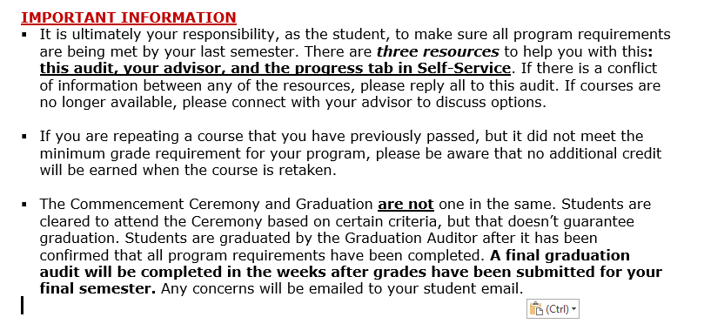
Audit highlights
The subject line of the email will identify:
Your last name
Graduation Audit
Abbreviations of declared programs
Ex.
“Newton Graduation Audit – BA.PSYC with M.WGS”
Important Information – please read!

Slide 12
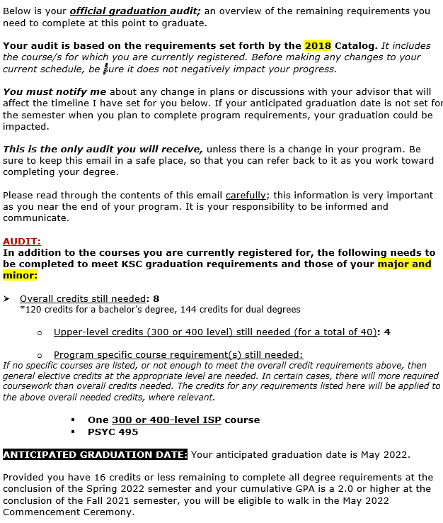
The Body of the audit
IDENTIFIES:
Catalog year: Specifies graduation requirements for that year
Overall credits needed: Number of credits needed to get to 120 (or more for specific programs or dual degree)
Upper level credits needed: 300 or 400 level coursework (total of 40 credits required)
Specific course/GPA requirements: To meet ISP, major, or minor requirements
Anticipated Graduation Date: The last month of the semester it is anticipated you will complete your final requirements.
The audit image on the left is an example only – it is not representative of your specific requirements.

Slide 13
Anticipated graduation date
Your Anticipated Graduation Date (AGD) is tracked and updated by the Associate Registrar.
Your audit will indicate your AGD
Based on your registered credits and remaining requirements at the time completed.
If you change the way you are declared after the audit has been completed, a re-audit will be sent to you.
If your timeline changes because of your registration plan, you decide to take summer courses, etc. – it is your responsibility to make sure your AGD has been updated accordingly. ‘Reply’ to your audit with the updated information.
If your AGD is not set for the semester you plan to complete requirements, you will not be added to the list of students to be reviewed for graduation!

Slide 14
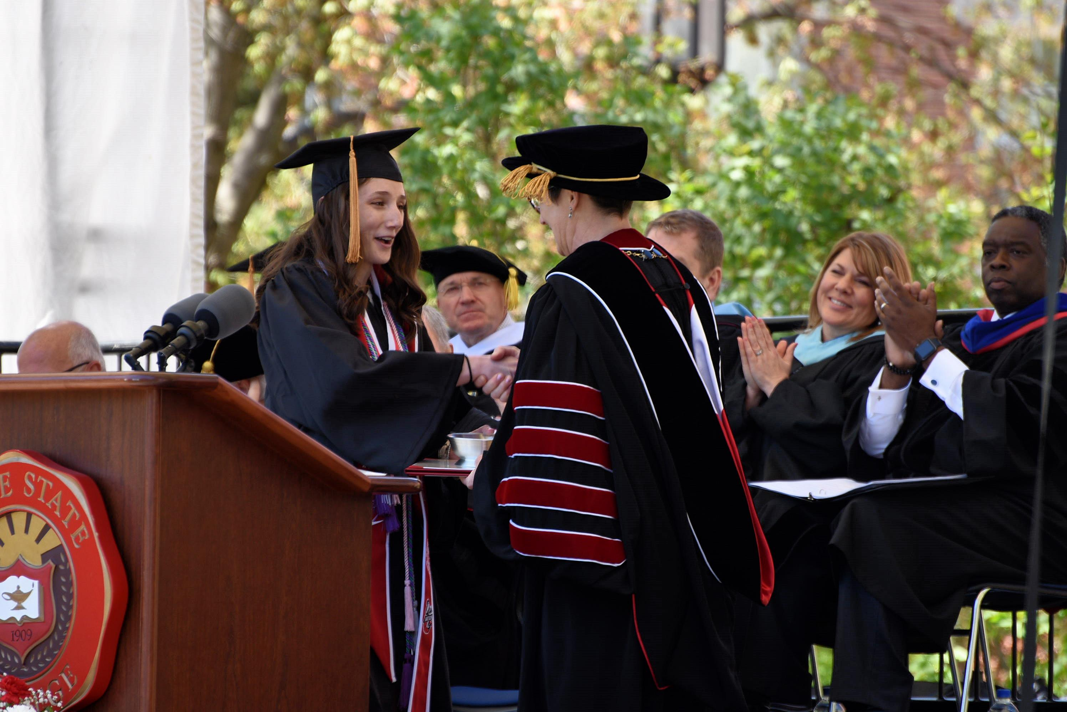
Commencement eligibility
POLICY REQUIREMENTS FOR ELIGIBILLITY
Eligibility to attend Commencement is determined during the graduation audit process based on policy.
Eligibility is reviewed again the second week of spring semester.
Students are notified via KSC emails if eligibility has not been met.
If policy requirements are met, it is assumed you will walk at the first Commencement Ceremony for which you are eligible.
A 2.0 minimum cumulative GPA at the end of the semester prior to Commencement
Must be within 16 credits of completing requirements at the conclusion of the spring semester
Have graduated in the current academic year, are currently enrolled, OR for students who are transferring in final coursework, can provide evidence of enrollment in final requirements
Must be completing degree requirements by the conclusion of the Fall semester of the same year as the Commencement Ceremony.

Slide 15

Your
resources
GRADUATION AUDIT
STUDENT PLANNING
ADVISOR
Applying to graduate on time usually means receiving your graduation audit before the fall semester of the year your expect to graduate. If you apply to summer or fall, you may receive it during that fall semester.
Ensuring program requirements are met is a responsibility that ultimately falls on you, the student.
Three resources to help you ensure you are meeting program requirements. Your audit should match what you see in Student Planning and what your advisor has told you. If it doesn’t, reply all to your audit – don’t ignore it!
Available anytime you log into Self-Service. You can check your Progress tab to see where you stand in meeting requirements, view how you are declared, and find out who your advisor is.
Meeting with your advisor is strongly encouraged to help ensure you are registering for the right courses and to help you graduate on time.

Slide 16


After you receive your audit
EVERYTHING LOOKS GOOD!
MY AUDIT DOESN’T LOOK RIGHT!
Make sure you stick to what your audit told you to do!
Be aware of and earn minimum required grades and GPA’s (overall and major specific).
If you make a change in your schedule or plan, be sure you communicate with the graduation auditor!
If you change your declaration, be sure to complete a Declaration of Major form. This will likely prompt a re-audit.
Communicate!
Connect with your advisor/s and the graduation auditor to discuss your concerns.
The earlier you address concerns, the better!
If you aren’t sure – ask! Don’t assume.

Slide 17
*Your last semester*
The Associate Registrar starts completing final audits the last day of the semester.
  The audit can’t be completed until all grades have been submitted.
If all requirements are met – you will be graduated.
  Congratulatory letters and unofficial transcripts will be sent to the diploma address you provided.
  Diplomas are mailed separately. They can take about 4-6 weeks from the date they are ordered .
  IMPORTANT: Notify the Associate Registrar if your mailing address has changed. Changing your permanent address DOES NOT change your diploma address
If there are items preventing you from graduating, you will be notified by email via your KSC email and a letter (if no response received from the email)
All of the above steps are completed at the end of the process after all students have been audited. This can take several weeks – please be patient.

Slide 18
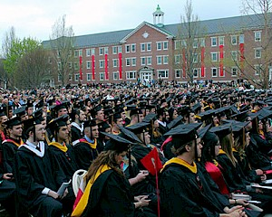
COMMENCEMENT 2022
Visit https://www.keene.edu/campus/events/commencement/ for Commencement related information

Slide 19

Congratulations grads!
QUESTIONS???

