Slide 1

From Applying to Graduate to Graduation

Slide 2
Table of Contents
Links to pages:
7
When should I apply?
What if I’m graduating in December but want to walk next year – do I still apply?
What if I don’t want to walk at Commencement – do I still apply?
What if I missed the deadline – is it too late?
I think I’m graduating this semester, but I haven’t declared my major yet. Now what?
Ok, turns out I need to apply. What now?
Where can I see how I’m declared?
8
9
10
11
12
13

Slide 3
Table of Contents (cont.)
Links to pages:
14
It looks like I’m not declared the way I should be. How do I fix it?
I’m still declared in a major/minor I’m not completing. Do I need to do anything?
I want to change my dual major to two degrees. How do I do that?
Why is my catalog year important?
Steps to apply to graduate
Special notes about the diploma address
Ok, I applied but I entered the wrong completion date and/or entered other incorrect information. What do I do?
15
16
17
18-26
27
28

Slide 4
Table of Contents (cont.)
Links to pages:
29
I applied to graduate. How long before I get my graduation audit?
I got my audit back and everything looks fine. Do I need to do anything else?
I got my graduation audit and I’m concerned that some of the information doesn’t match what I thought. Who do I talk to?
My graduation audit doesn’t match what my advisor told me. What do I do?
My audit said my graduation was pushed back to December, but I’m finishing in the summer. What now?
30
31
32
33

Slide 5
Table of Contents (cont.)
Links to pages:
34
My audit said my graduation was pushed back to December, but I made some changes so I can graduate in May. Do I need to do anything else?
I was going to finish in May, but now I can’t finish until December. Won’t you just know that?
So I did change my primary major after I applied to graduate. What should I do now?
I added/deleted a second major and/or minor(s) after I applied to graduate. Do I need to reapply?
Commencement vs. Graduation
35
36
37
38

Slide 6
Table of Contents (cont.)
Links to pages:
39
Commencement Eligibility
Communicate! Don’t Assume!
Contact Information
40
41

Slide 7
When should I apply?
Applications are due by May 1 of your junior year (the year in which you have earned 60+ credits)
  Ex. If you are graduating anytime in 2017, your application is due by May 1, 2016

Slide 8
What if I’m graduating in December but want to walk next year – do I still apply?
Yes!
Applying to graduate is about graduating – not walking however you can’t do either without applying. Graduation audits will assume you want to walk in the current year. To change that, simply reply to the audit indicating you would like your Commencement date changed to the following year.

Slide 9
What if I don’t want to walk at Commencement – do I still apply?
Yes!
Again, applying to graduate is about graduating, not walking. You can’t graduate (and receive your diploma) without applying to graduate.

Slide 10
What if I missed the deadline – is it too late?
No!
Applications can be accepted at anytime, however submitting past the due date can cause other [mostly] avoidable complications, the most serious of which is you not being able to graduate on time.
Other potential issues for applying late:
Not on the list for senior activities such as Red & White Night
You won’t be able to attend the Commencement Fair
Name will not appear in the Commencement book

Slide 11
I think I’m graduating this semester, but I haven’t declared my major yet. Now what?
You cannot graduate (or apply to graduate) without first declaring your major. Submit a Declaration of Major form to the Registrar’s Office and then apply to graduate.

Slide 12
Ok, turns out I need to apply. What now?
Make sure you are declared properly. If you are changing majors and/or minors, do so BEFORE applying.

Slide 13
Where can I see how I’m declared?
If you go into My Progress in Student Planning, you should see all degrees, majors, and minors that you have declared and are currently active.

Slide 14
It looks like I’m not declared the way I should be. How do I fix it?
Using a Declaration of Major form, you can make any necessary changes to your program including:
Changing, adding, or deleting a degree/major/minor*
Changing your advisor
Changing your catalog year
* Sometimes requires the signature of your advisor

Slide 15
I’m still declared in a major/minor I’m not completing. Do I need to do anything?
Yes. You must submit a new Declaration of Major form with the program you are no longer completing in the “Delete Academic Program” section.
You do not need to fill out your major information again or obtain your advisor’s signature to delete a program.

Slide 16
I want to change my dual major to two degrees. How do I do that?
If we have an advisor’s signature on file for both majors, you can simply email us in the Registrar’s Office and ask to have changed your dual major to two degrees. If we don’t, you will need to submit a new Declaration of Major form with your second advisor’s signature.
**IMPORTANT – you need 144 credits to graduate with two degrees

Slide 17
Why is my catalog year important?
Each year program requirements are published in the KSC catalog. Your catalog year determines which requirements you are responsible for completing in order to graduate.
Notes:
Catalog year is typically the year you were officially enrolled at KSC
Your catalog year must be the same for all your majors and minors

Slide 18
The actual act of applying to graduate
Up next…

Slide 19
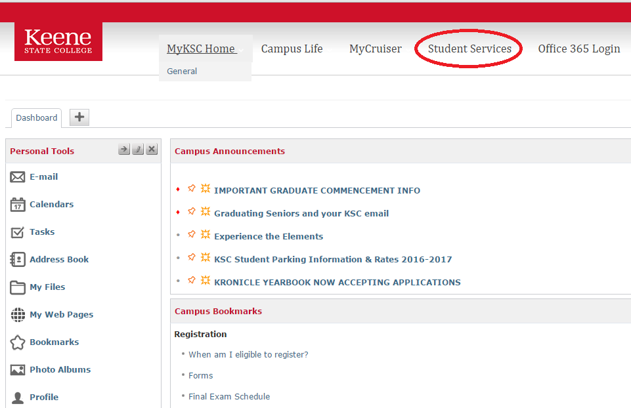
Applying to Graduate
Sign on to MyKSC and choose Student Services
Step 1

Slide 20
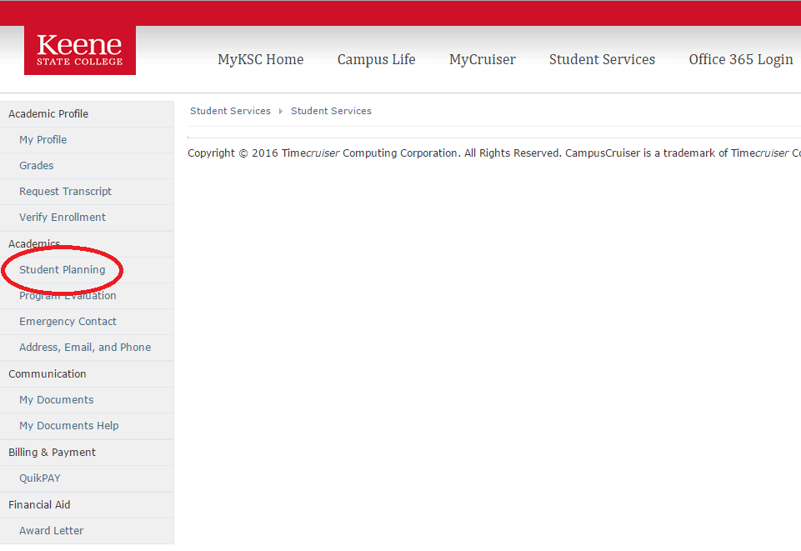
Applying to Graduate
From Student Services, choose Student Planning
Step 2

Slide 21
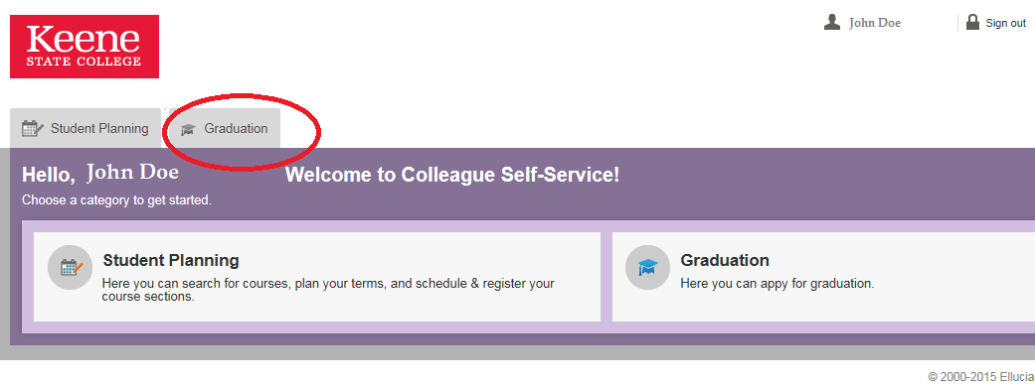
Applying to Graduate
Once in Student Planning, choose the Graduation tab
Step 3

Slide 22
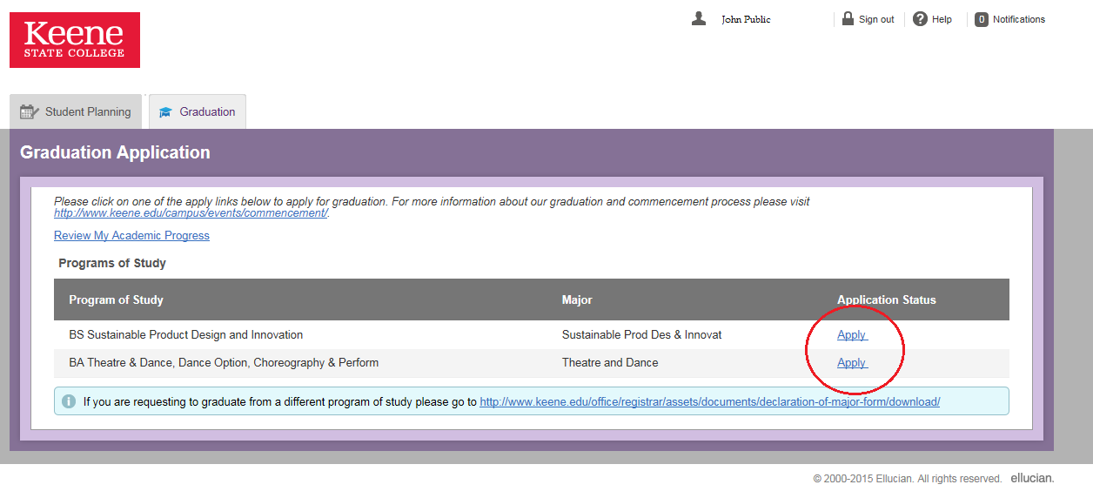
Applying to Graduate
Once you have chosen the graduation tab, all declared degrees will show up with an active [Apply] link next to each.
Notes: To graduate with two degrees, you need to apply for both.
If you have a dual major (not two degrees), only your one degree with your primary major will appear
Step 4

Slide 23
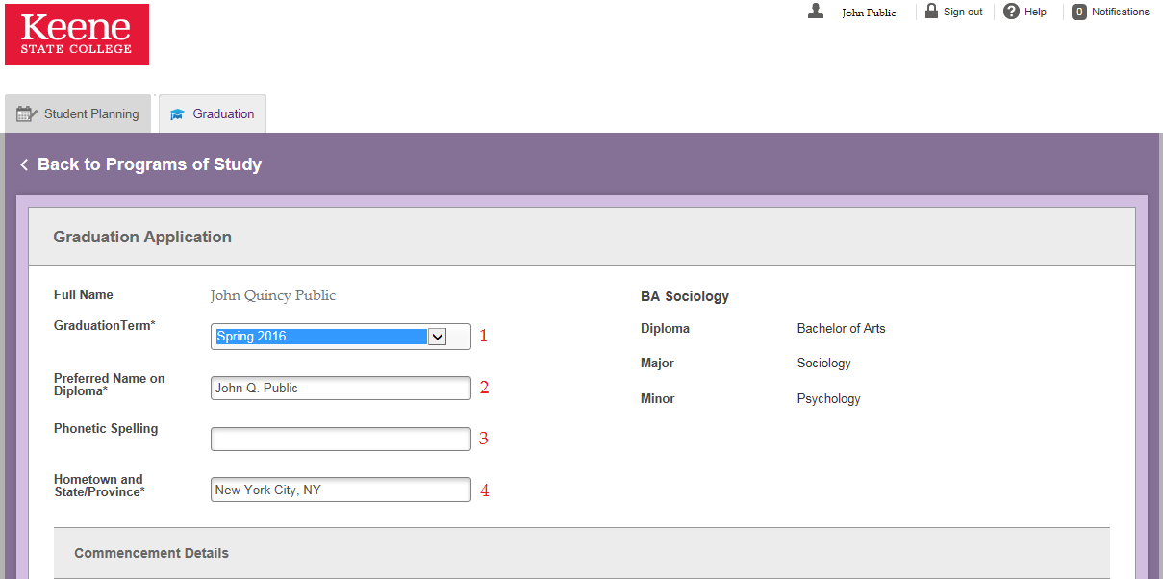
Applying to Graduate
Once you have clicked the [Apply] link, the application appears.
Tips for entering the information:
Your graduation term is when you will finish all degree requirements, not when you want to walk
Edit your name here as you would like it to appear on your diploma (must be your legal name)
Step 5

Slide 24
Applying to Graduate
Tips for entering the information (cont.):
Use the phonetic spelling field if your name is difficult to pronounce. (This is for Commencement)
Be sure to enter your hometown and state for graduation announcements to be sent
Step 5 (cont.)

Slide 25
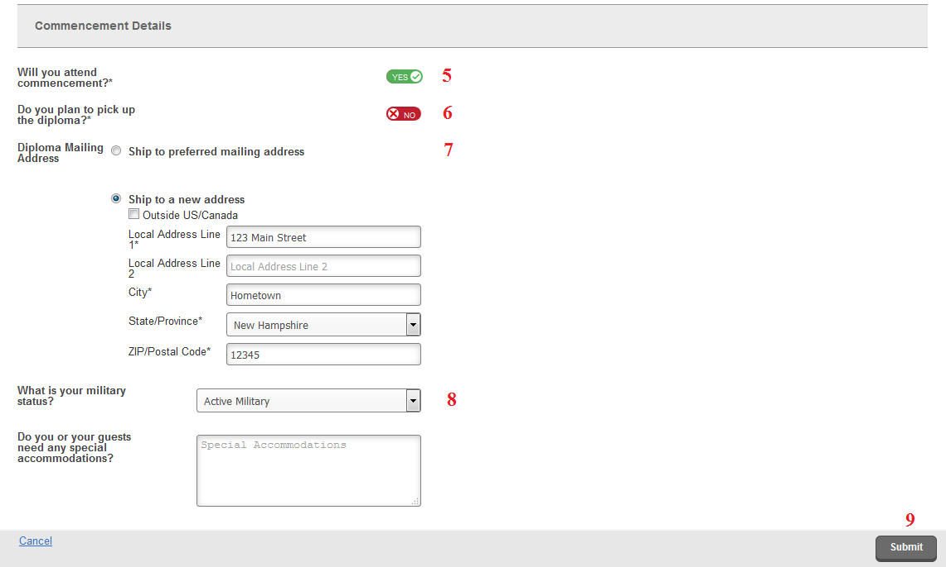
Applying to Graduate
Tips for entering the information (cont.):
Currently this is not being used as an RSVP to commencement.
If you don’t plan to pick up your diploma in person approximately 12 weeks after you graduate, check NO here. Diplomas are not handed out at Commencement.
Step 5 (cont.)

Slide 26
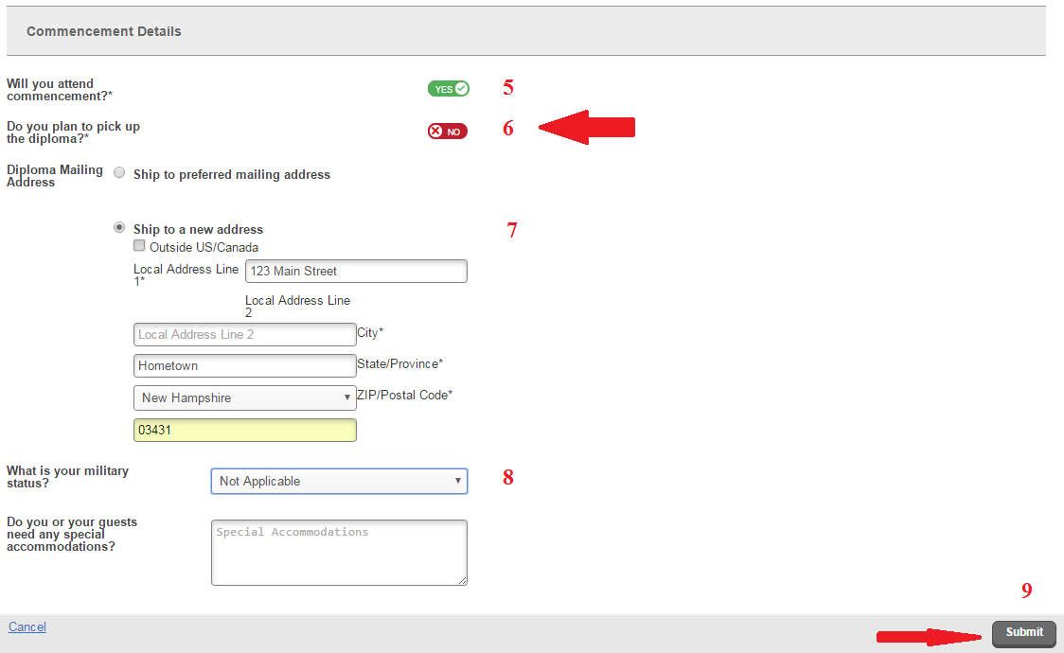
Applying to Graduate
Tips for entering the information (cont.):
You have the option of where you would like your diploma mailed to. Remember – they can take up to 12 weeks to be mailed
If you have military status, please indicate so here.
Submit!
Note: We are not currently using the special accommodations feature. If you will have special accommodations, you will have a chance to indicate that later.
Step 5 (cont.)

Slide 27
Special notes about the diploma address
The address you submit for the diploma only affects where your diploma is mailed. It does not change your permanent address.
If you move after you applied to graduate and you updated your permanent address, it does NOT change your diploma address. You will need to update both.
Your diploma can be mailed anywhere you choose to have it sent.
Remember - your diploma is mailed up to 12 weeks after you graduate!

Slide 28
Ok, I applied but I entered the wrong completion term and/or entered other incorrect information. What do I do now?
Email me at bhamel@keene.edu and let me know. Once you have applied, you can’t reapply again unless you have changed your major.

Slide 29
I applied to graduate. How long before I get my graduation audit?
It depends on when you plan to graduate and when you applied. It can take anywhere from a 24 hours to a few months. If you apply by May 1 for the following spring, I try to have all audits done by the start of the fall semester. (Audits go out all summer)

Slide 30
I got my audit back and everything looks fine. Do I need to do anything else?
You’re all set for now, but if anything changes later with your program, you must let me know.

Slide 31
I got my graduation audit and I’m concerned that some of the information doesn’t match what I thought. Who do I talk to?
Me! Reply to the email to let me know of your concerns. My job is to make sure you have met graduation requirements. If I am looking for you to take a specific course you think you’ve finished, you must let me know so I don’t hold up your graduation unnecessarily.

Slide 32
My graduation audit doesn’t match what my advisor told me. What do I do?
Let me know. The most common scenario is there is a substitution happening that I’m not aware of yet. You need to get that taken care of. Occasionally a mistake has been made. The important thing is that we catch and correct it in time. Don’t ignore it!

Slide 33
My audit said my graduation was pushed back to December, but I’m finishing in the summer. What now?
You need to let me know if you plan to finish up in the summer months, otherwise I won’t be looking at your program again until December. And you’ll probably call me in October wondering where your diploma is.

Slide 34
My audit said my graduation was pushed back to December, but I made some changes so I can graduate in May. Do I need to do anything else?
Yes – you need to let me know. As is often the case, I’m not aware when changes to your program have been made unless you tell me.

Slide 35
I was going to finish in May, but now I can’t finish until December. Won’t you just know that?
No! With 1,000+ students to keep track of, most of the time I don’t know when something changes unless you tell me.
**If you plan to register for courses at KSC in the fall, you won’t be given a registration time if our records show you are finishing in May, so let us know!

Slide 36
So I did change my primary major after I applied to graduate. What should I do now?
First, let me know. I cleared you to graduate based on your previous major so you’ll need me to re-do your audit
Second, you need to reapply to graduate with your new major
Note: If you skip the first step and/or the second step, you have not been officially cleared to graduate!

Slide 37
I added/deleted a second major and/or minor(s) after I applied to graduate. Do I need to reapply?
No. You applied to graduate from your degree with your primary major so you do not apply again. You DO want to let me know however because I will need to re-audit your program for graduation.

Slide 38
Commencement vs. Graduation
Commencement is a ceremony where family, friends, and members of the academic community gather to celebrate your accomplishments. While often referred to as “Graduation” this is technically incorrect.
Graduation occurs when you finish all degree requirements.

Slide 39
Commencement Eligibility
Must have a 2.0 or higher cumulative GPA at the conclusion of the fall semester prior to Commencement
Must have 16 credits or less remaining at the conclusion of the spring semester to complete all degree requirements

Slide 40
Commencement Eligibility (cont.)
As is sometimes the case, you may be cleared to participate in Commencement at the time of your audit, however if it is determined at some point later that you are no longer eligible, you will be notified.
If it was determined that you were not eligible but something has changed that you think will impact your eligibility status, let me know.

Slide 41
Communicate! Don’t Assume!
You may have noticed a common thread throughout these slides – “let me know”. Help me to help you. Never assume I know– your graduation could be on the line.

Slide 42
Contact Information:
Barbara Hamel
Associate Registrar / Graduation Auditor
603.358.2355
bhamel@keene.edu
Elliott Room 180

