Slide 1
How to Register using
Student Planning

Slide 2
Log into MyKSC
MyKSC > Student Services gives access to Student Planning.
Student Planning is the tool used for registration, searching for classes, checking your progress toward your degree and creating a plan that will help your complete your degree on time!

Slide 3

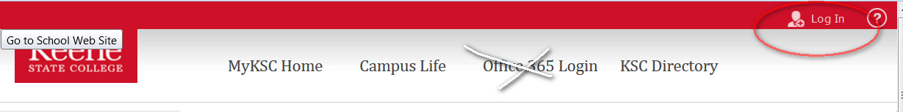
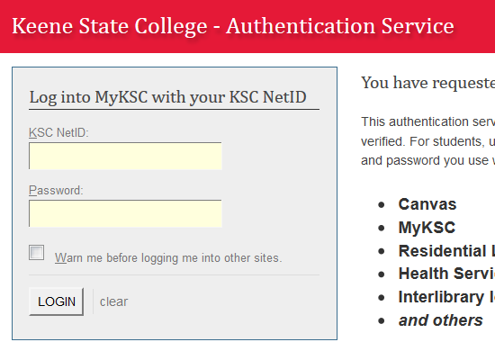
How do I get to MyKSC????
www.keene.edu

Slide 4

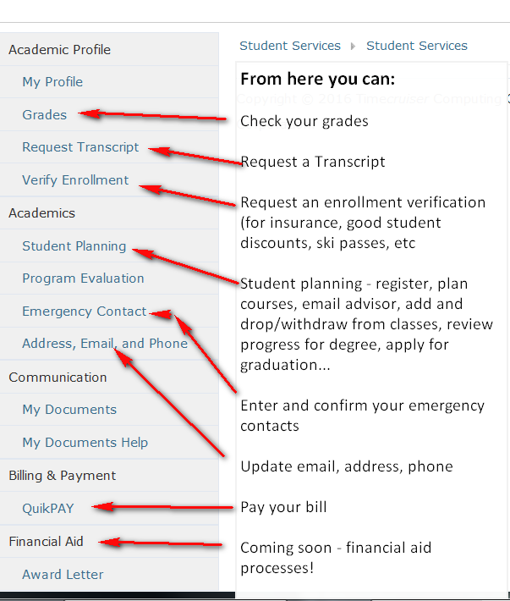
I’m here, now what do I do?

Slide 5
Student Planning
Student planning has many tools you can use.
My progress – shows how your courses fit in your degree requirements
a great starting point to look for classes
Load a course plan to see how your program has set some of the timing for completing major requirements
“Degree Shopping” – if you are undeclared, see what courses you need for a potential major
Plan and Schedule - plan your courses or actual sections for next term or the next 4 years
Course Catalog -Search the course catalog for courses you need. You can filter by all kinds of details
Test Summary – Did you take the Praxis? Math test?
View/Print an unofficial transcript

Slide 6
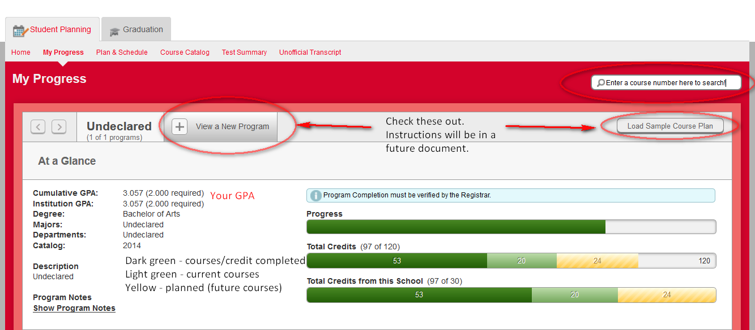
Where do I start?
For registration - you can start different ways.
My Progress

Slide 7
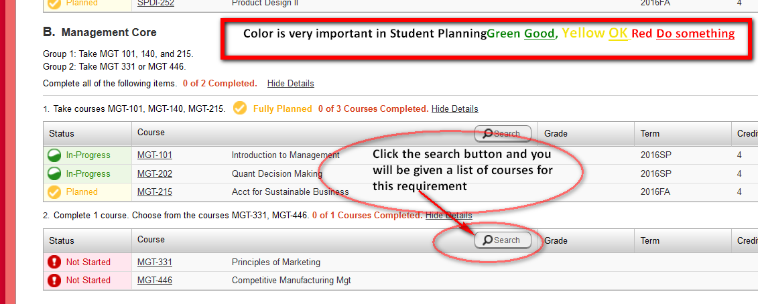
My Progress

Slide 8
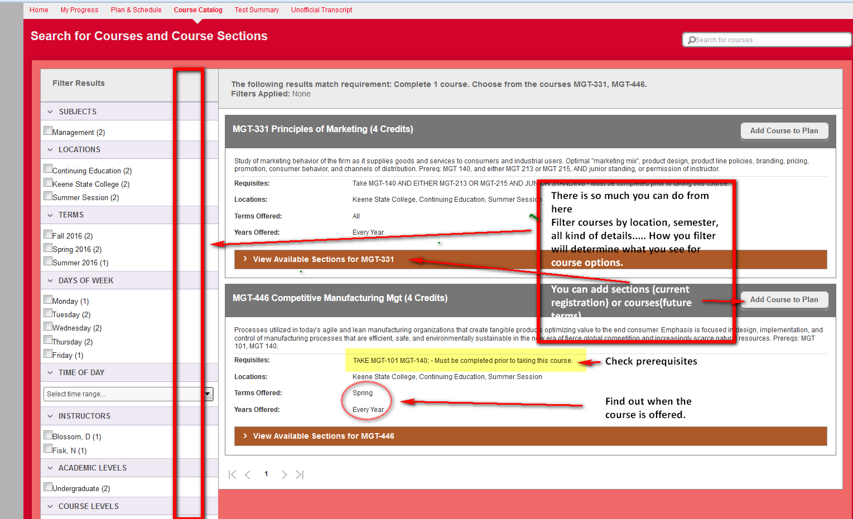
I clicked the Search button

Slide 9
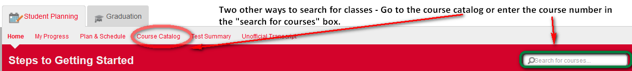
Remember that we clicked Search button and we’ll come back to that.

Slide 10
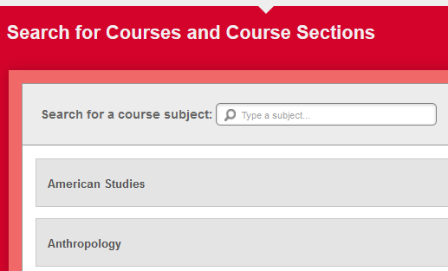
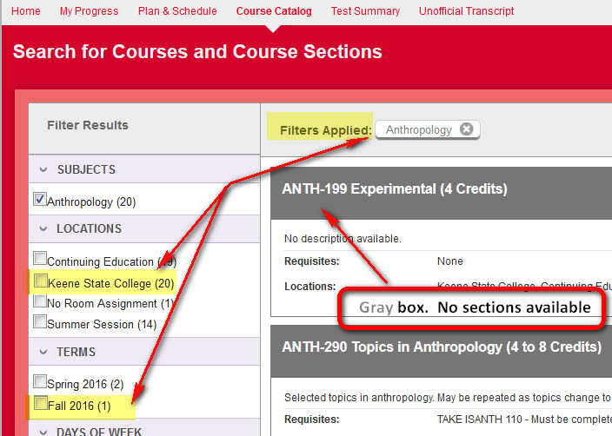
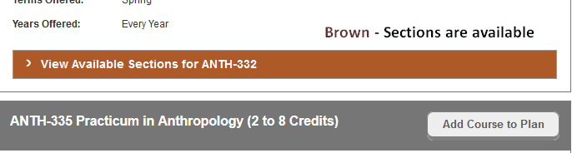
Course catalog will show a list of subjects. Click on a subject and a list of courses are shown. Notice the colors of the boxes around the course name and number. Gray – courses, Brown - sections

Slide 11
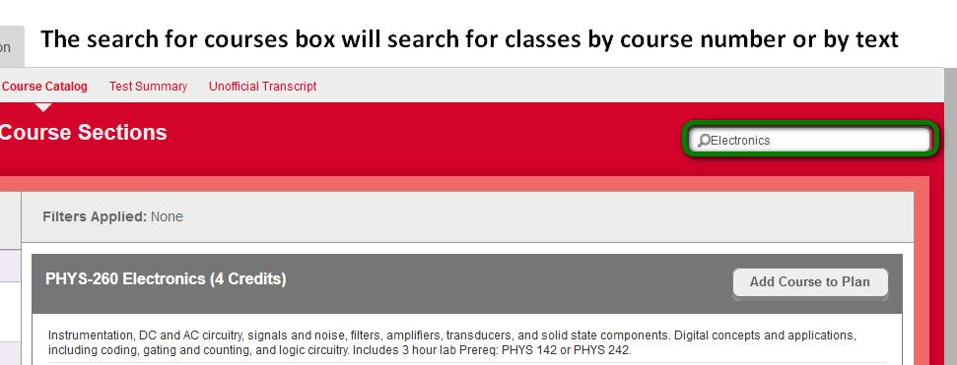
The “Search for Courses” box.

Slide 12
Remember when I clicked the Search button?

Slide 13
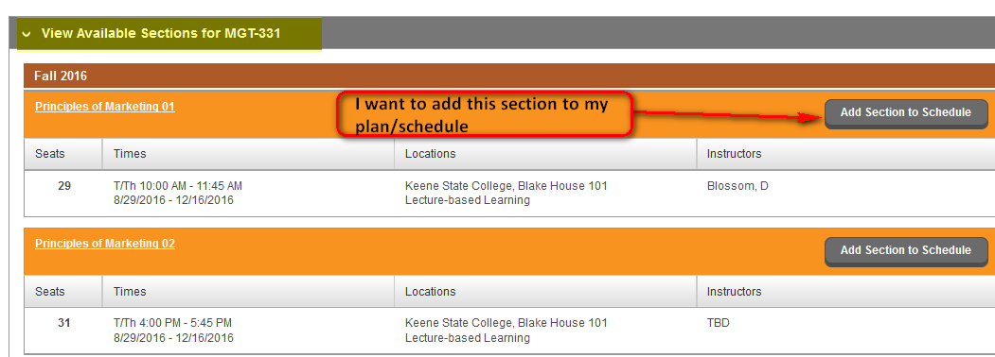
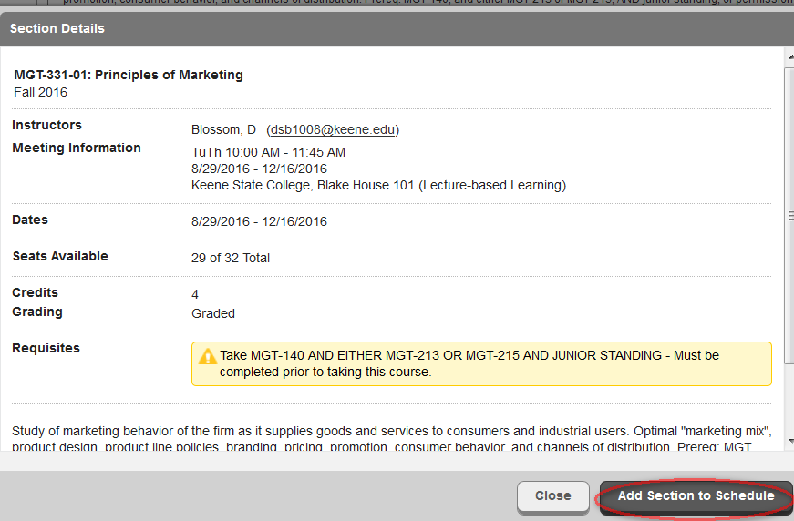
I clicked on “View Available Sections”. I selected the section I wanted and clicked “Add section to schedule. This is NOT registering for a course – but we are getting closer.

Slide 14
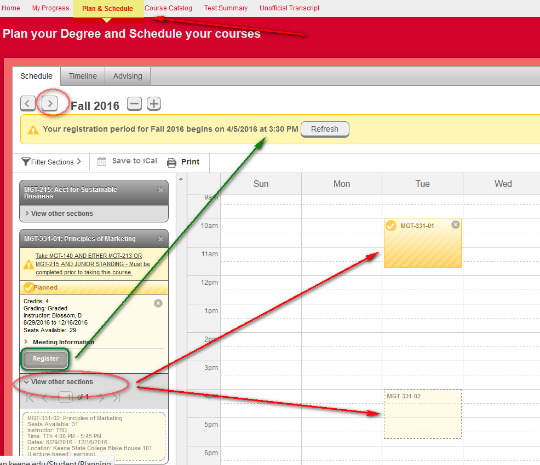
After I added the section to my schedule, I went to plan and schedule and the semester for registration, selected calendar view, and the section I selected is on my schedule. I can see when my registration time is, how the section fits in my schedule, how other sections of this course fit my schedule, and the button to press when I an ready to register for classes.

Slide 15
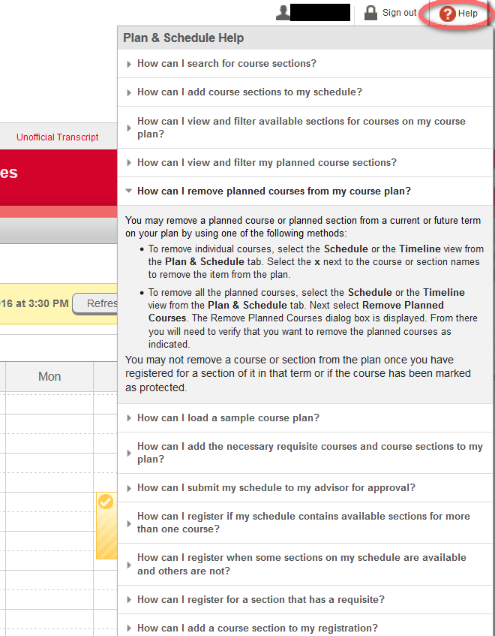
While we’re here – Look at all this help that is available!

Slide 16
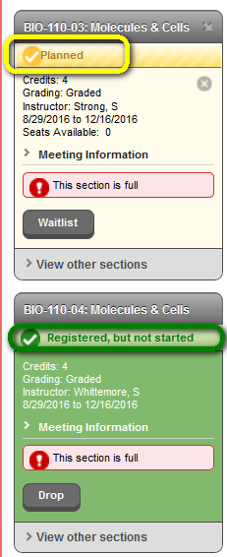
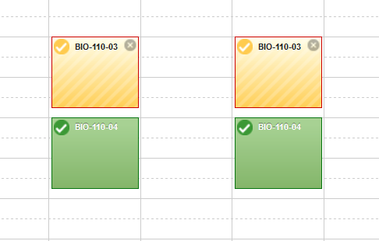
When I click register – Remember the colors?
Green Good, Yellow OK, Red Do Something
Same colors for registration!

Slide 17
This is a quick overview of how registration works using student planning.
If you have additional questions, send me an email (enieckoski@keene.edu) or come to Academic Advising or the Registrar’s office.

